Slide 1
Strava
How to make it even better!

Slide 2
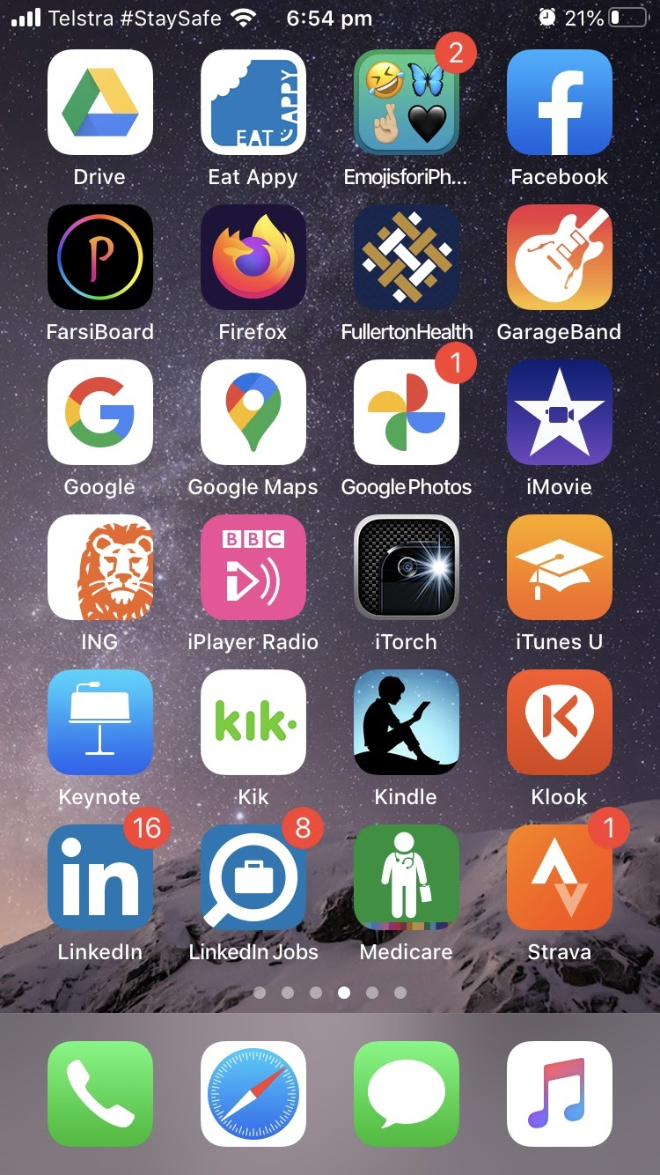
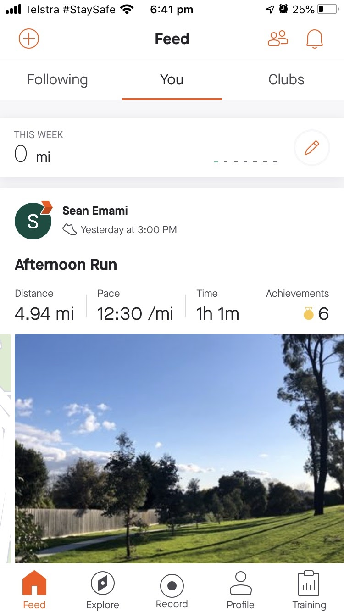
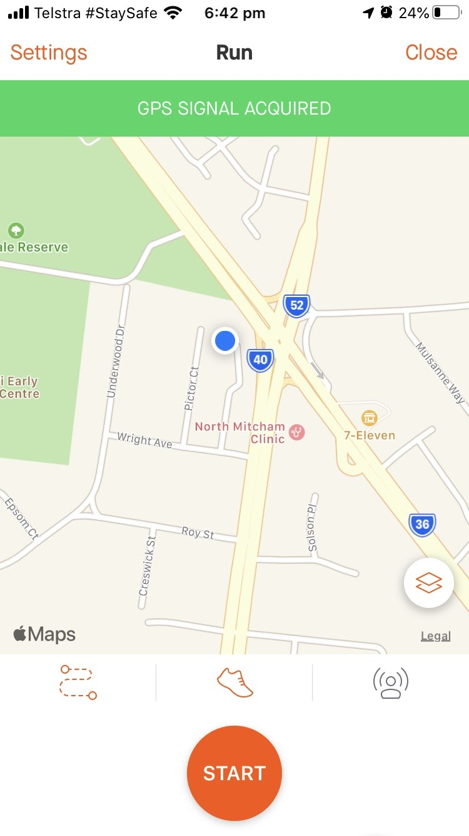
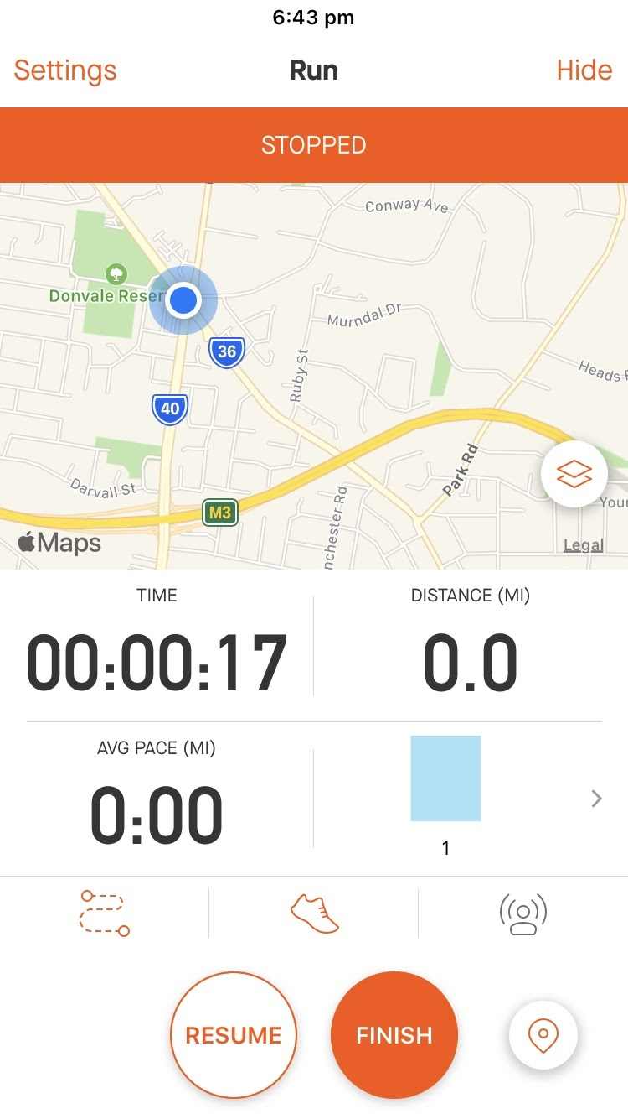

Slide 3
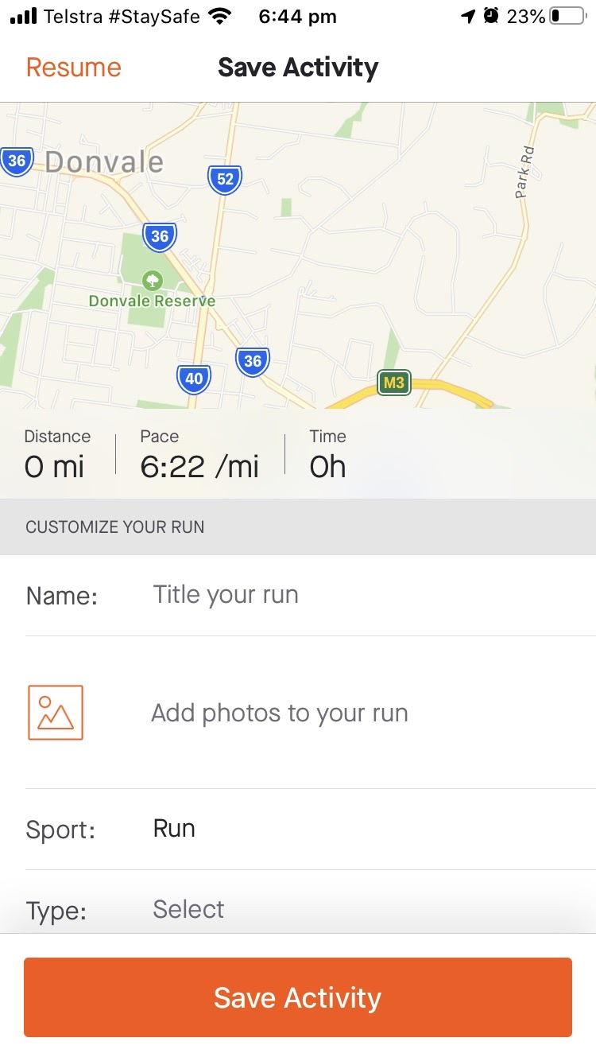
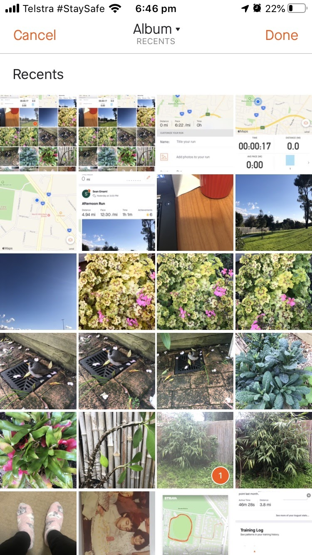
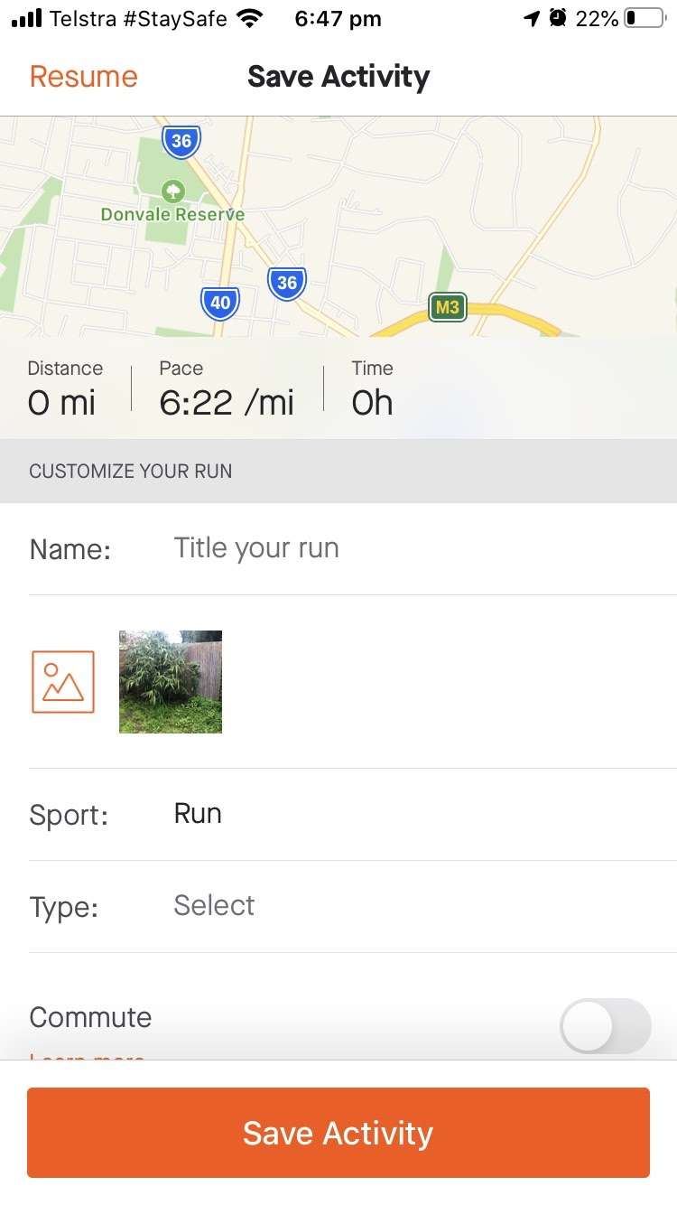

Slide 4
Issues uploading photos ? Hunch
Desktop research and interview finding

Slide 5
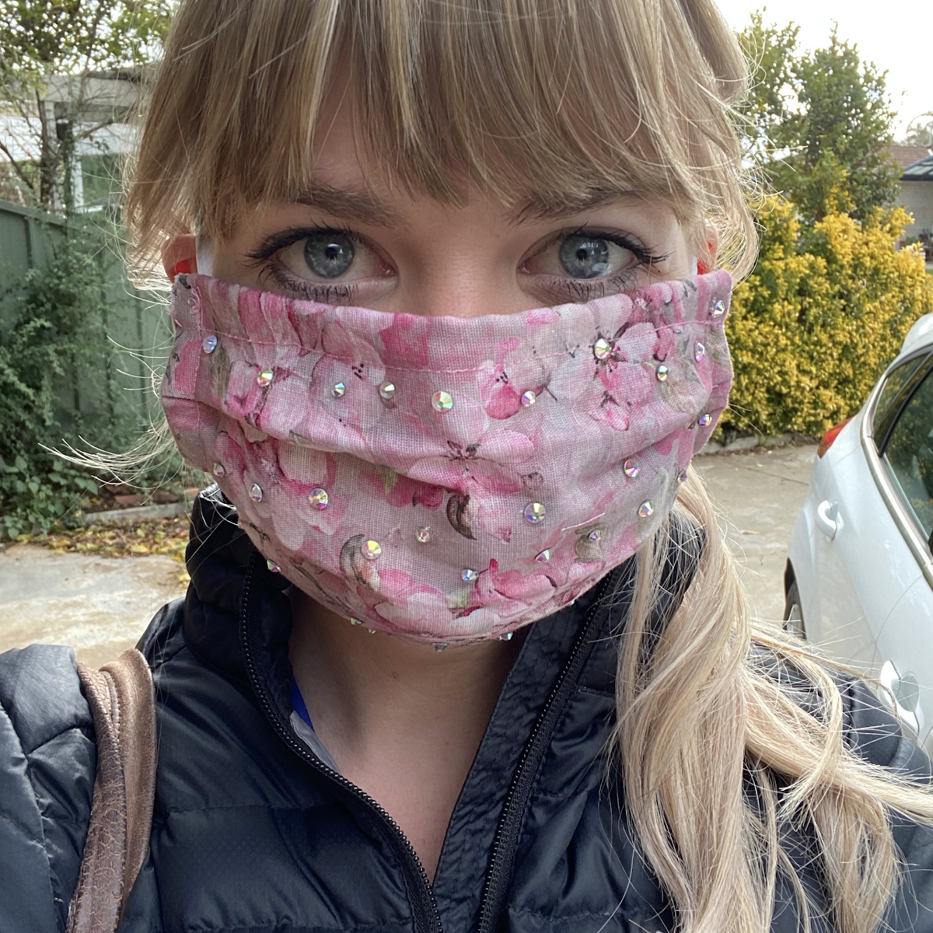
Desktop research and interview finding
“It’s hard to see where to upload photos, especially if you have already saved your activity”
“ Once you have picked a photo from your album, the thumbnail is too small to see what photo you have uploaded”
“The very first few times I tried to upload an image, it brought me to tears! Your eyes are drawn to Save Activity and you miss your chance to upload an image”

Slide 6
In depth Interviews
?
Interview questions
How was your day? What did you do today? What are your hobbies?
Do you do any sports? Do you have a fitness goal?
Usability questions
How long have you used Strava?
Have you used any other application similar to Strava? If so, what are they?
What do you like the most about Strava?
Do you like to share images or photos with your recorded activity?
How often do you share images or photos with your recorded activity?
How do you find the experiences of uploading an image or photo to add to your recorded activity?
Can you show me how you record and then post a photo with your recorded activity?
Is there anything about uploading an image or photo that you like to change?
You mentioned you used other applications for recording activities, how was your experience uploading images using those applications?
Do you know of a better way or is there an app for easily sharing your experience and photos?
Do you have any suggestions about the app?

Slide 7
Affinity mapping and findings
Posting images is something that most Strava users would like to do. It keeps them motivated.
Most users expect the same user flow for uploading images to Strava as with other social media platforms or apps. And since this is not the case, they get frustrated.
Users find uploading images difficult, especially to begin with. Icons are not visible and the thumbnail image is too small.

Slide 8
Recommendations
After completion of your activity highlight the “Add photo to your run” icon so it is more visible.
Larger thumbnails after you have selected an image to post. This is where you're about to save your activity, but you haven’t saved it yet.
After you have saved your image and you are thinking about adding another image, instead of having the + icon in the top left corner, either have an image icon or place that option in the top right side of the screen within the main menu (identified by 3 dots) .

Slide 9
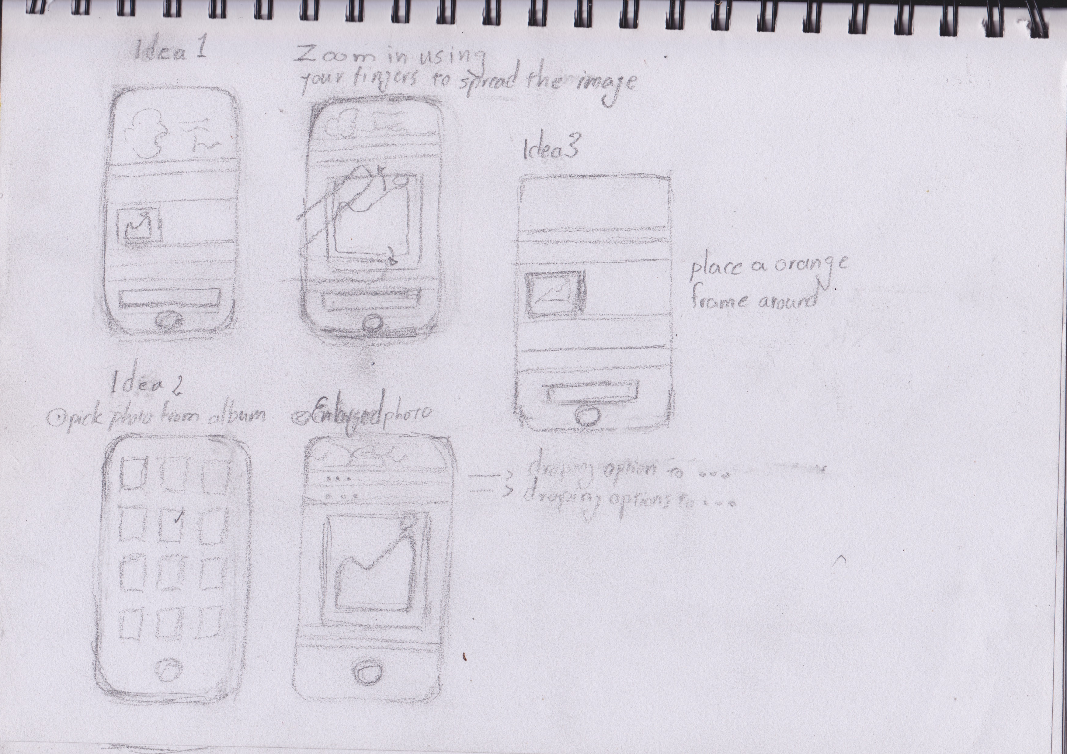
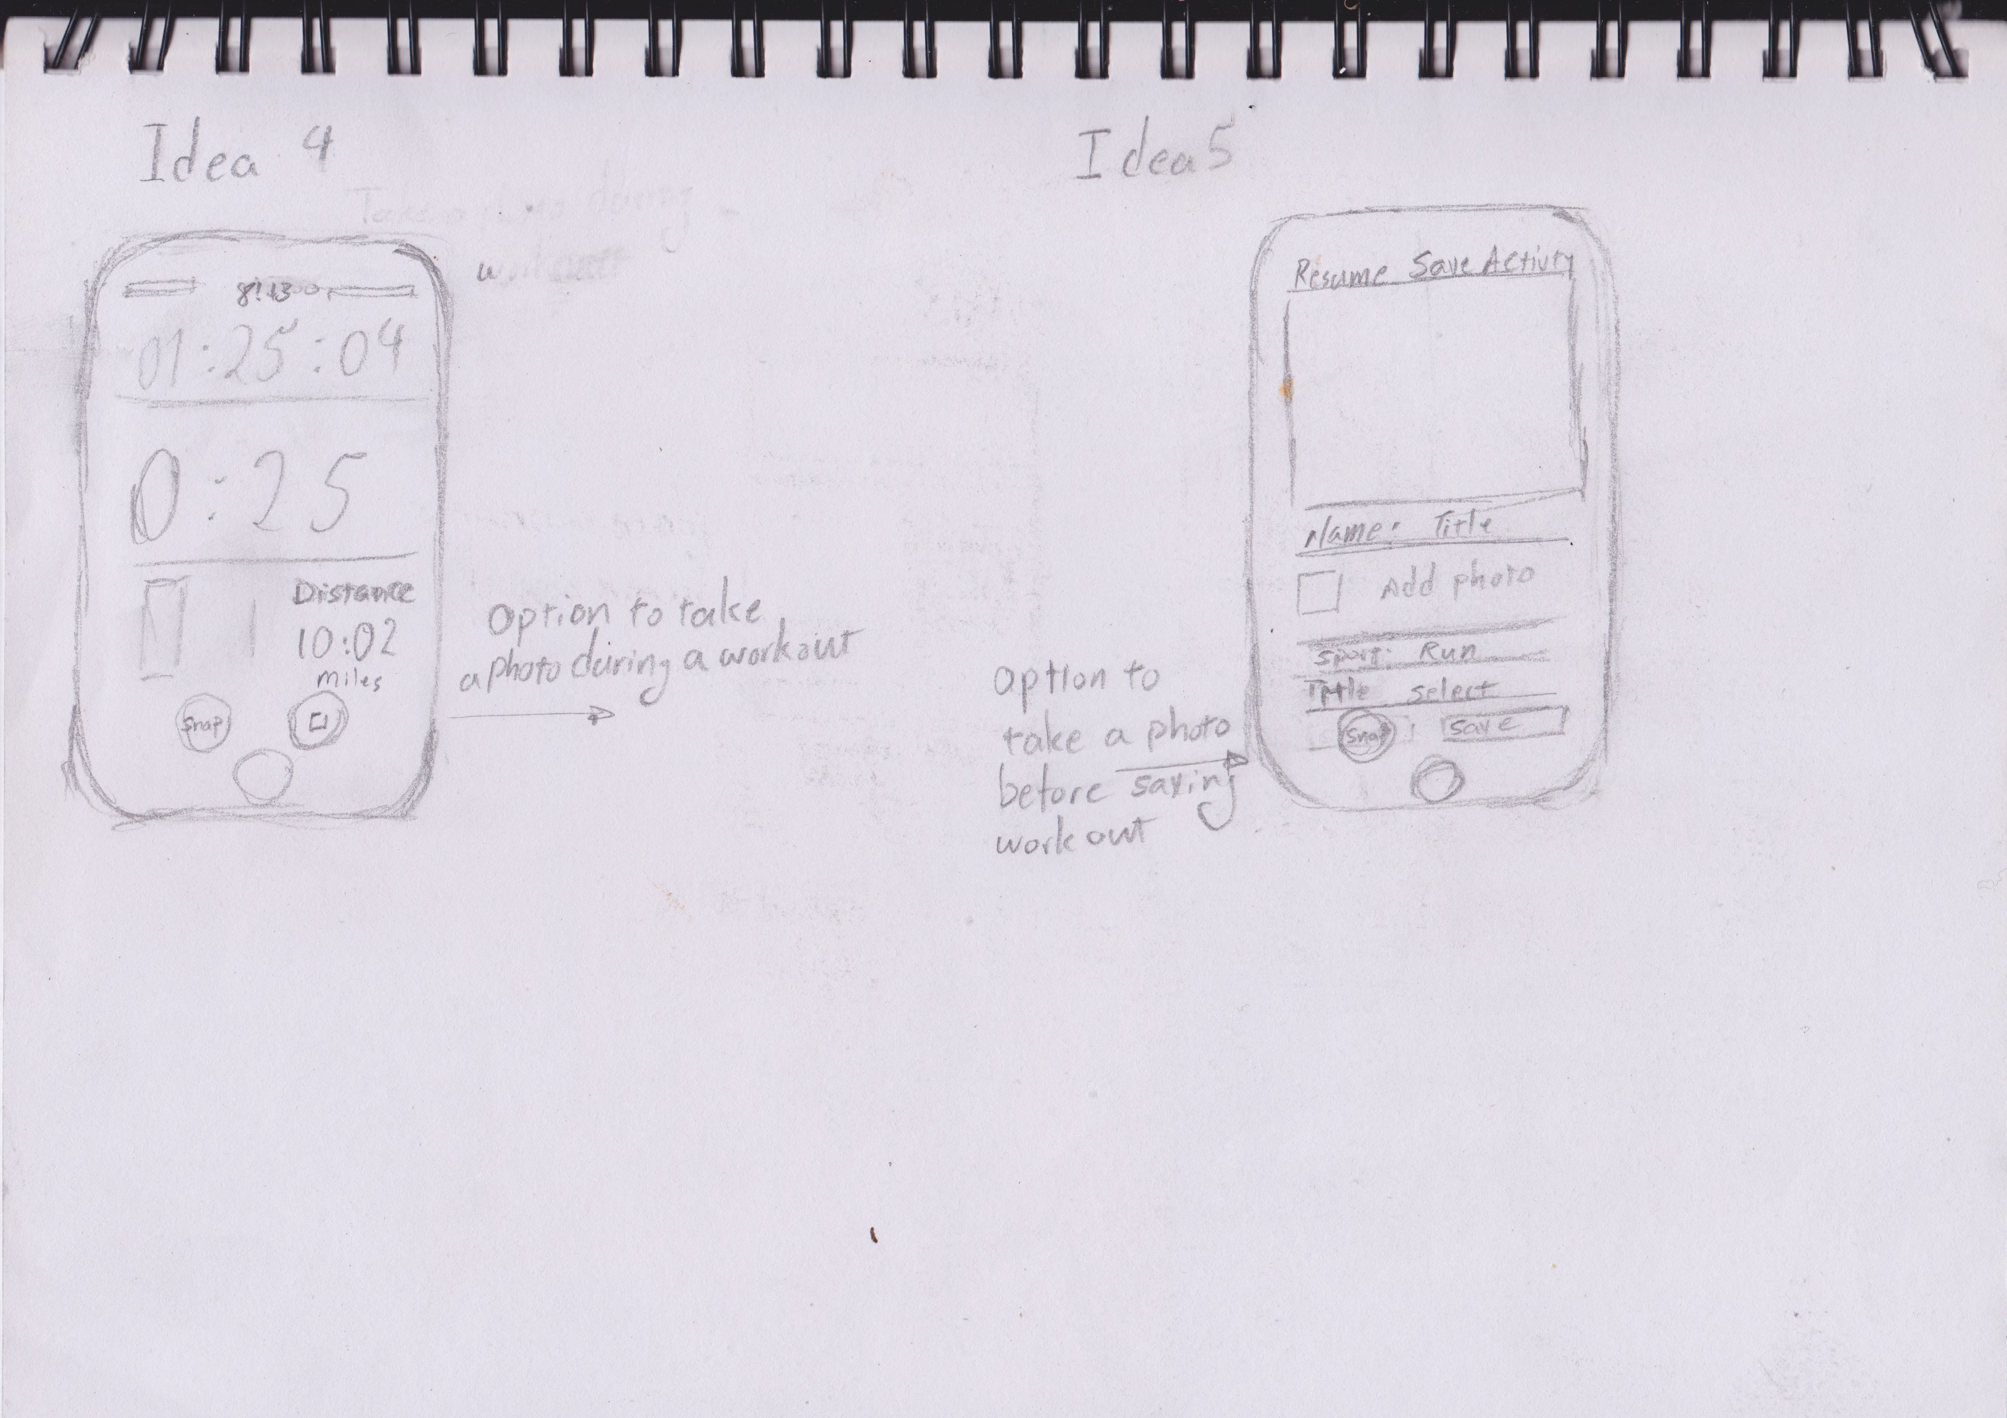
Ideation
Idea 1. User has uploaded the photo, then uses two fingers to enlarge the photo.
Idea 2. User selects a photo, and the photo is automatically enlarged and gone to Save your activity page. All the user must do is to press Save Activity.
Idea 3. Place a thick orange frame around the photo icon so when the user is about to save her or his activity, it’s easy to see where you can add images.
Idea 4. Users can take photos in activity tracking screen.
Idea 5. Users can take photos before saving the activity, so they have stopped the activity, but they haven't saved it yet.

Slide 10
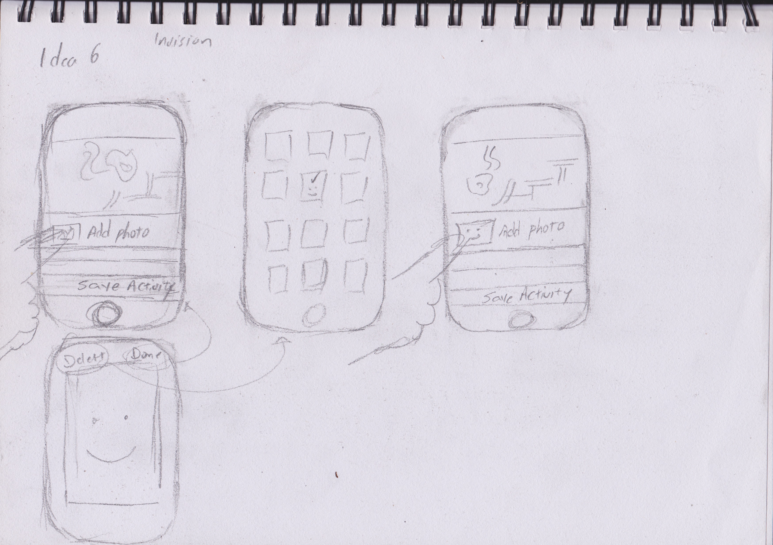
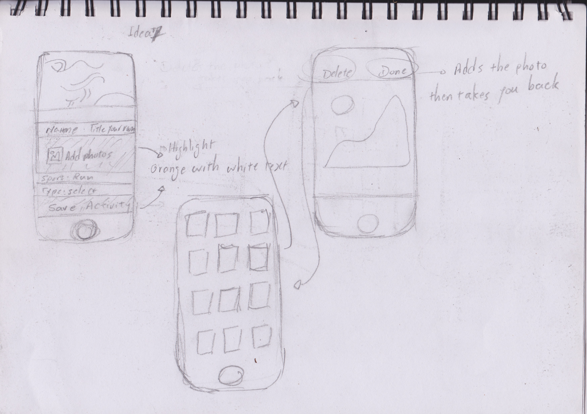
Ideation
Idea 6. When a user has selected an image and they have gone back to “Save Activity” page, they can tab on the image to enlarge it in its own screen. Then either to accept or delete the photo and go back to the album to choose another photo.
Idea 7. Similar to above but when an image is selected in Album, the image automatically enlarges, user either accept or chooses another image.
The second modification is to highlight the “add photo of your run” , bright orange.

Slide 11
Concept design
Introducing 2 solutions to our users for feed back
Click here to view solutions. :)
User feed back
. Highlight “Add photos to your run” Orange, the same as current ”Save Activity”.
. Both solutions – tab on image to enlarge or enlarge automatically is a good idea.

Slide 12
Low fidelity – Usability testing & iteration
Click here for Low fidelity prototype :)
User feed back
Users prefer the option where the image is automatically enlarged when it is selected, we incorporate that in our high-fidelity version and got users to test it again.

Slide 13
High fidelity prototype
Click here for high fidelity prototype :)
User feed back
. It would be great to choose more than one image for preview.

Slide 14
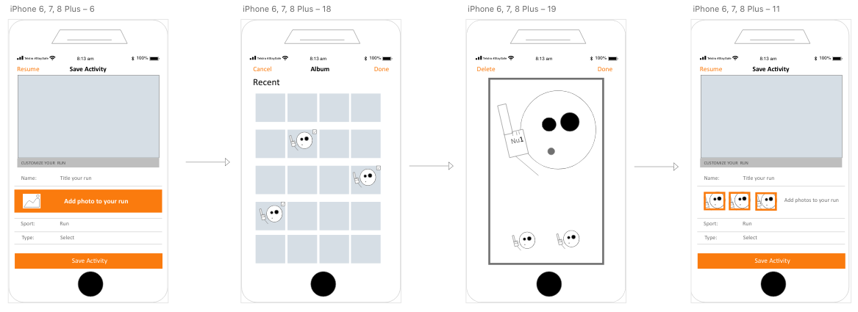
Coming soon the next iteration of high fidelity prototype

